Slide 1
Restaurant Revenue Prediction
DATA ANALYSIS – IBM INTERNSHIP

Slide 2
Introduction
Project Overview: In this project, I aim to predict restaurant revenue by analyzing various factors that influence it. By utilizing data analytics and machine learning techniques, we can identify key predictors and improve revenue forecasting for restaurants.

Slide 3
OBJECTIVE
To predict the revenue of specifics restaurant.
By identifying key variable that influences the data of the revenue fluctuation.
Developing a model that can predict the restaurant revenue based on the existing the data will be the important objective of this project.

Slide 4
EXPLORATORY DATA ANALYSIS - EDA

Slide 5
DATA COLLECTION PROCESS
The dataset used in this project is sourced from website called ‘Kaggle’. It contains various features related to restaurants, which are crucial for predicting revenue.
Dataset contains 8368 rows with 17 columns in it.

Slide 6
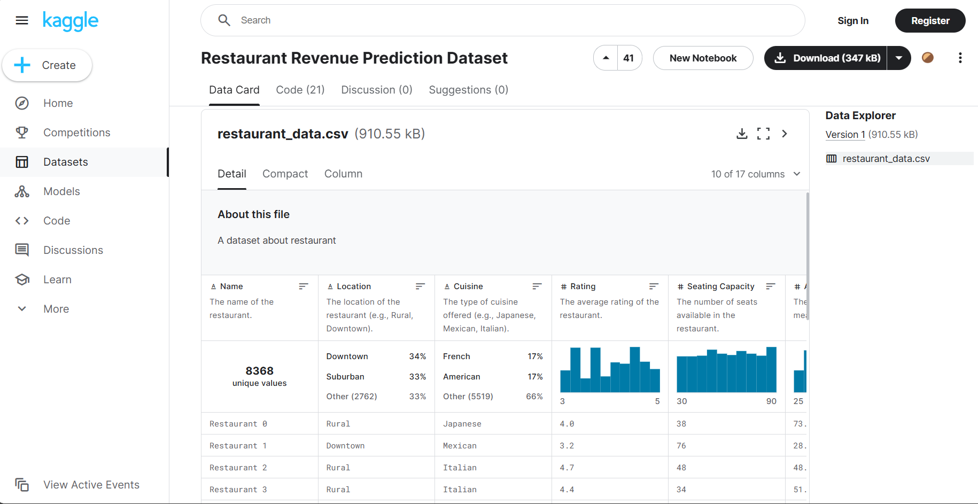

Slide 7
PREDICTION PLOTS (Seaborn & Matplot Libs)

Slide 8
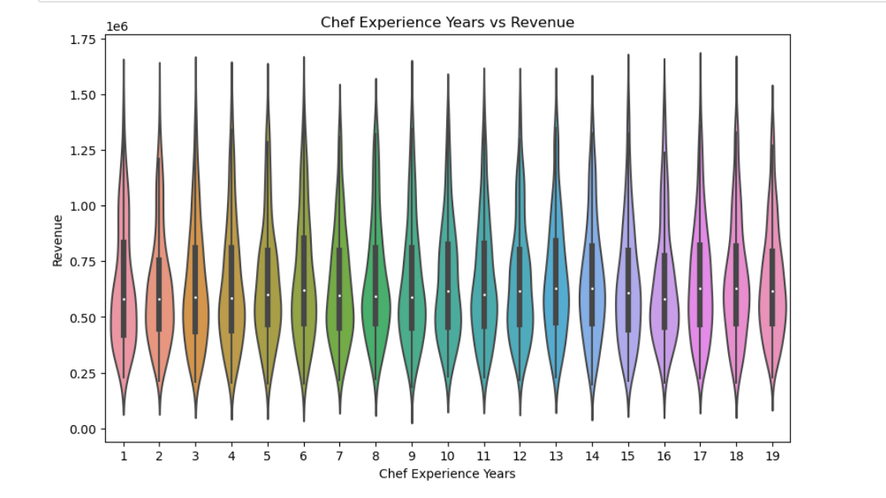

Slide 9
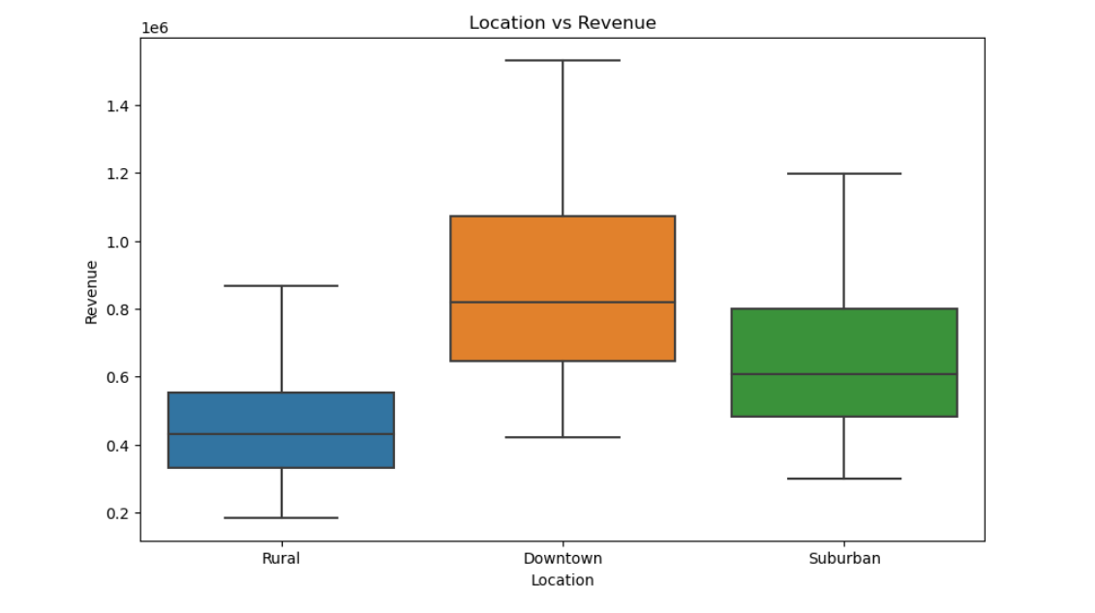

Slide 10
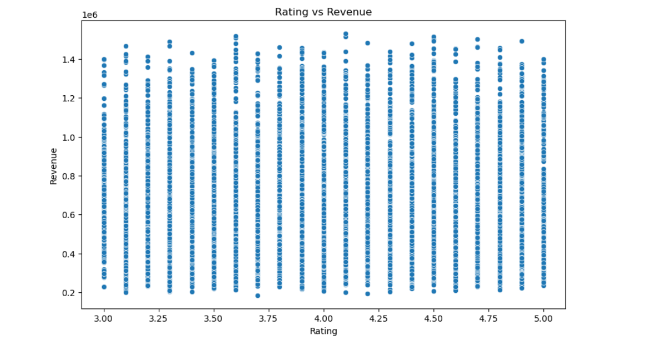

Slide 11
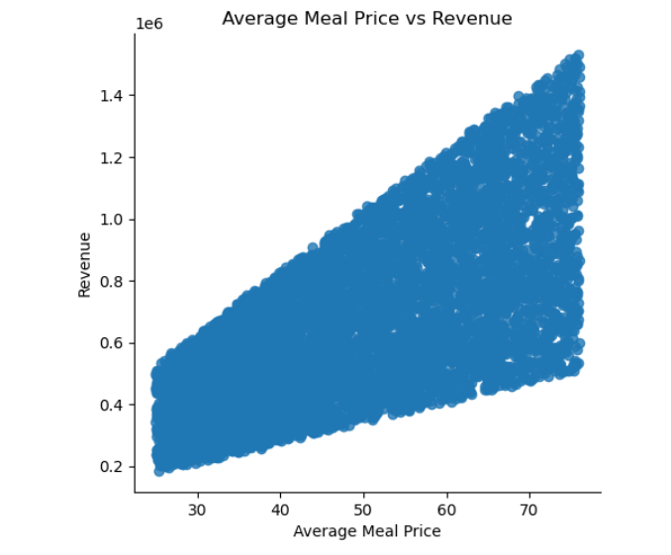

Slide 12
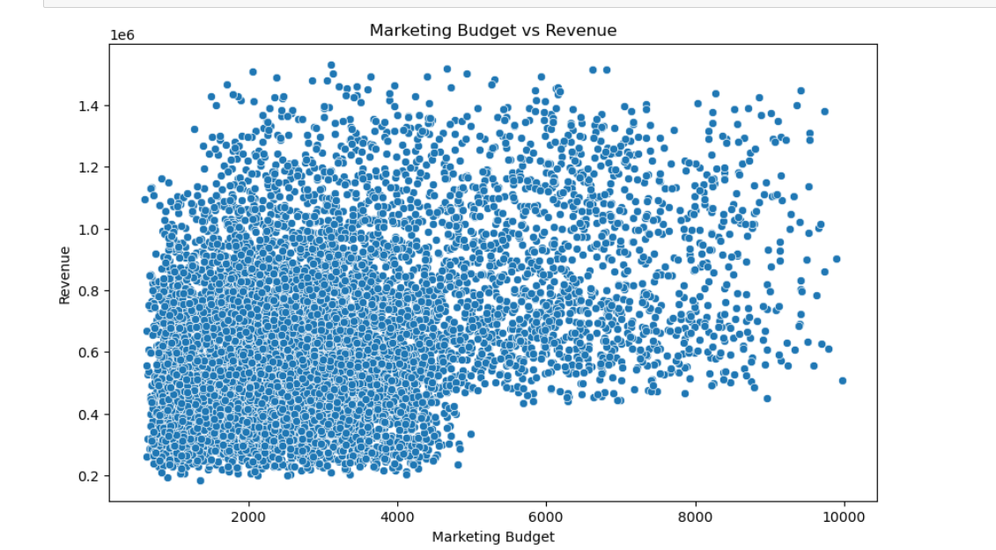

Slide 13
MAKING PREDICTIONS
Utilizing models
Linear Regression Model
Random Forest Model

Slide 14
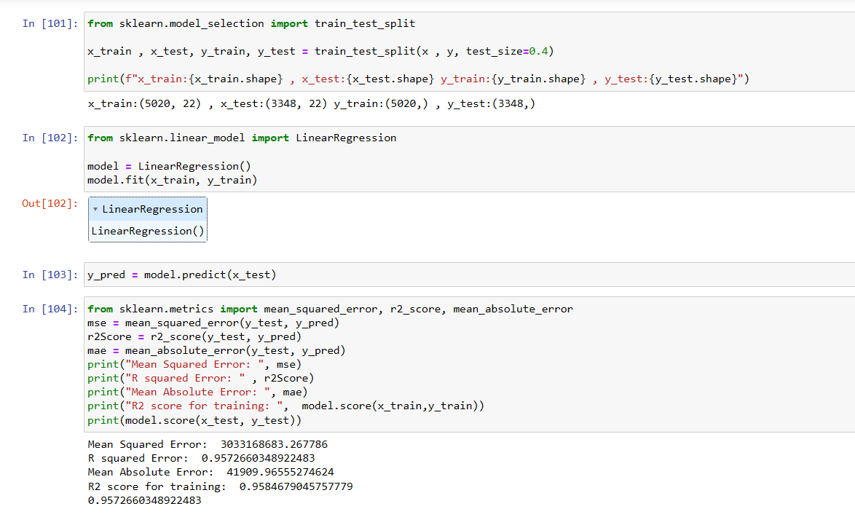
LINEAR REGRESSION MODEL (95.72%)

Slide 15
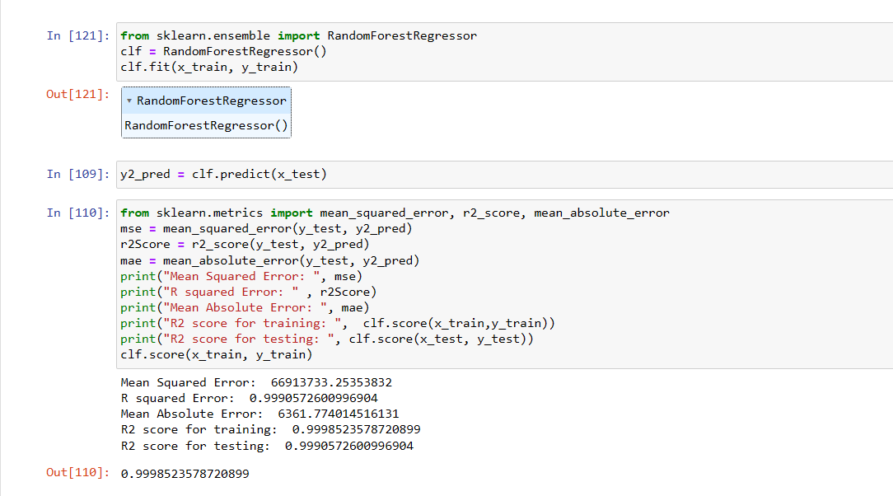
RANDOM FOREST MODEL (99.98%) SELECTED

Slide 16
CONCLUSION
The goal of this project was to predict restaurant revenue by analyzing various influential factors. By cleaning and preparing the data, conducting exploratory data analysis, and developing predictive models, we pinpointed key variables that affect revenue. Our findings emphasize the critical role of ratings, marketing budgets, and social media presence in determining restaurant revenue, offering valuable insights for restaurant owners and stakeholders.

Slide 17
THANK YOU

